Slide 1
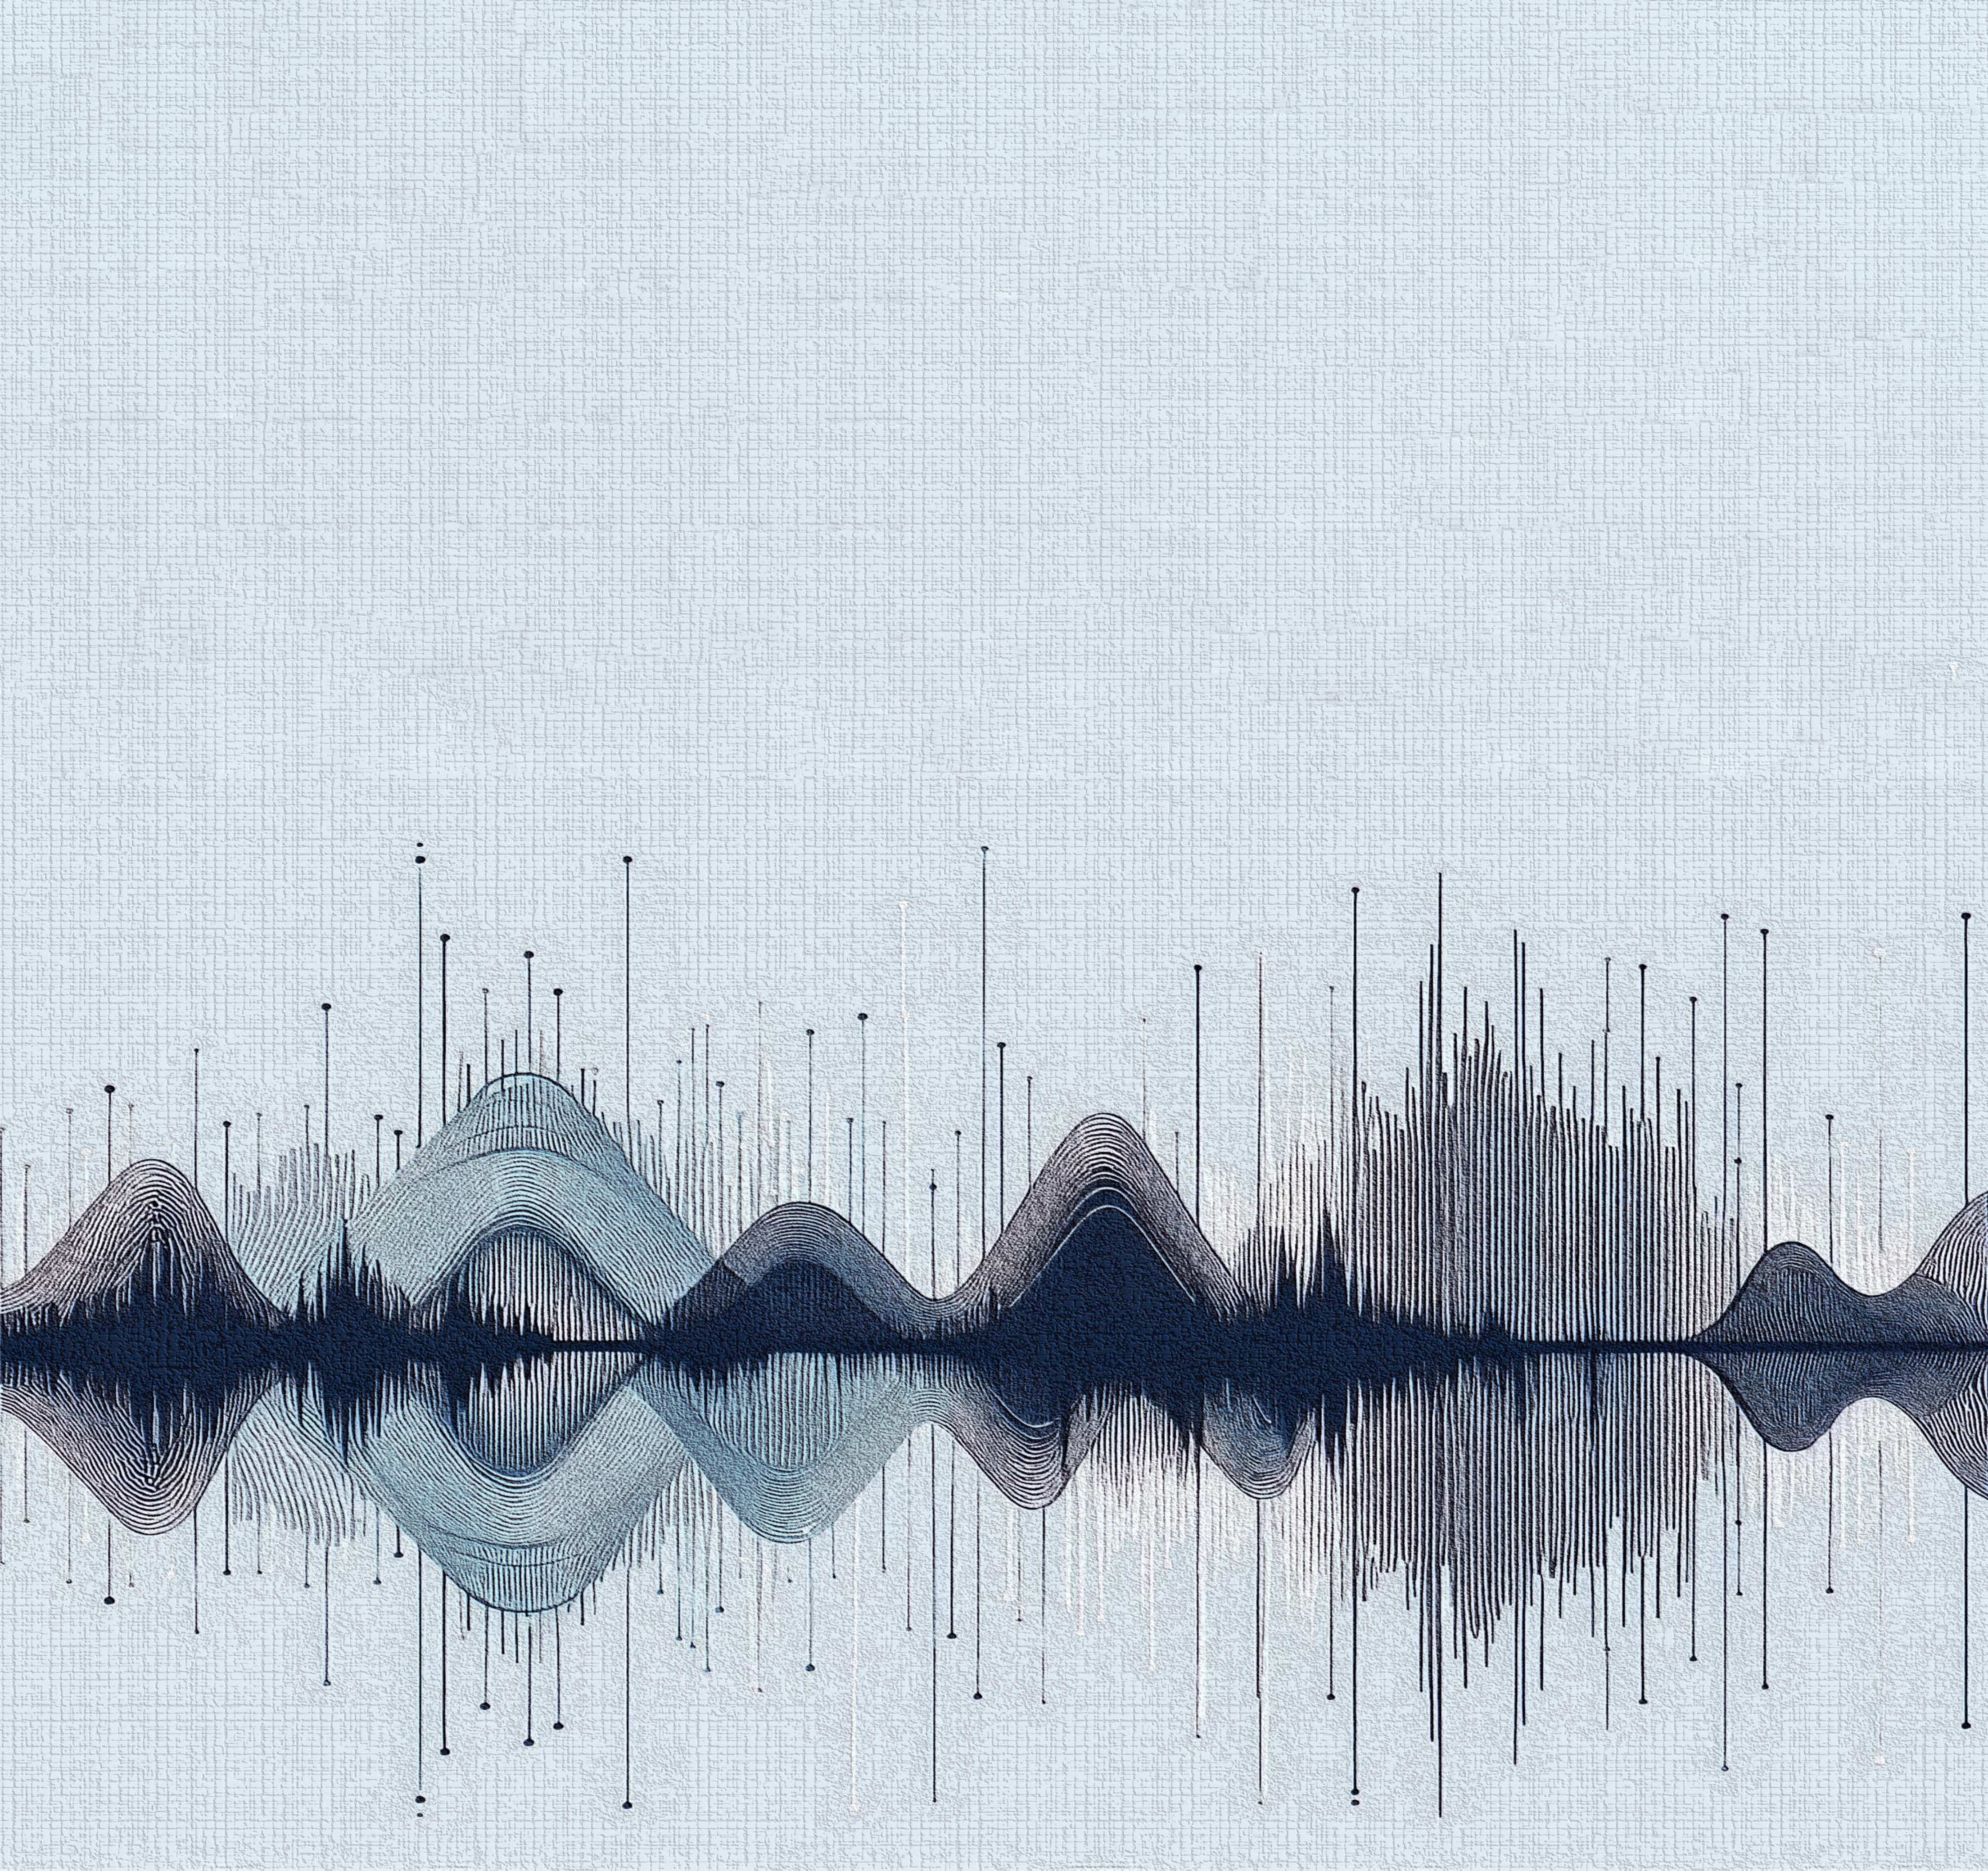



Muhammad Zain Ali
Seismic Detection Across Solar System
Team BETELWISE

Slide 2
Muhammad Zain Ali
Seismic Detection Across Solar System
Team BETELWISE

Slide 3
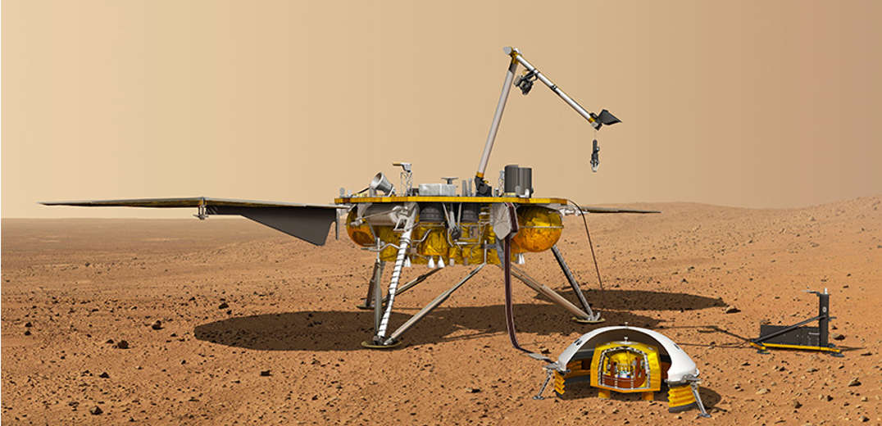
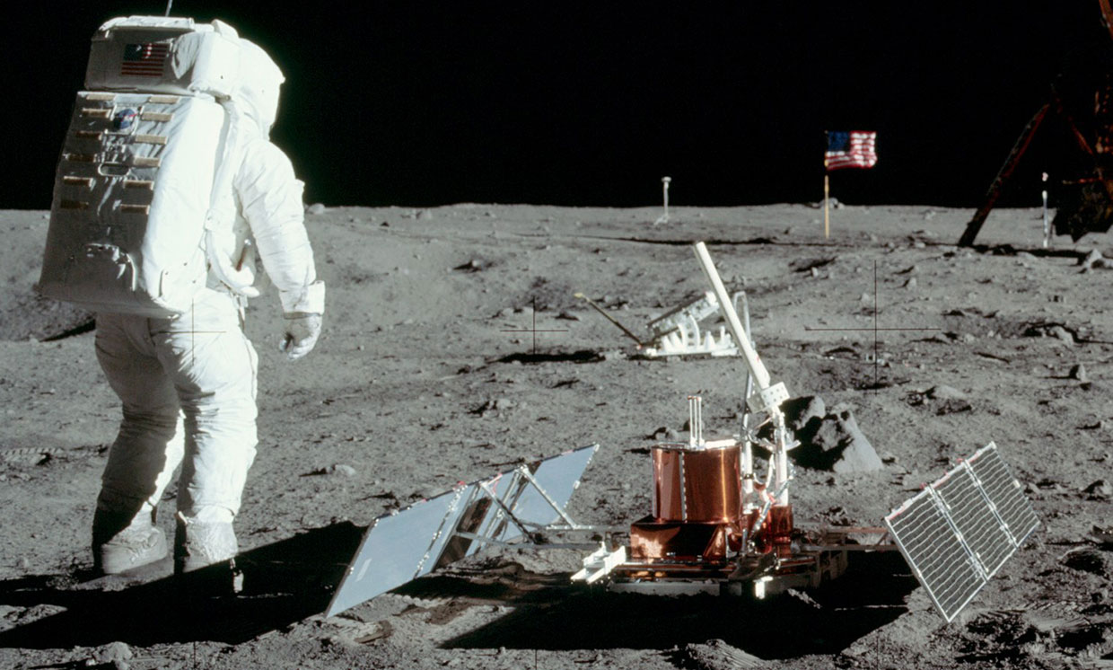
Seismic Detection Across Solar System
Team BETELWISE
About the Challenge

Slide 4
Seismic Detection Across Solar System
Team BETELWISE
About the Challenge
Planetary seismology missions face high power demands for transmitting continuous seismic data to Earth, much of which is unnecessary. The challenge is to develop a program that can analyze real data from the Apollo missions and Mars InSight Lander to filter out noise and identify significant seismic quakes.

Slide 5

Seismic Detection Across Solar System
Team BETELWISE
About the Challenge
Why this Challenge
Planetary seismology missions face high power demands for transmitting continuous seismic data to Earth, much of which is unnecessary. The challenge is to develop a program that can analyze real data from the Apollo missions and Mars InSight Lander to filter out noise and identify significant seismic quakes.
Previous Experience
in Seismic analysis
in Machine Learning

Slide 6
Seismic Detection Across Solar System
Team BETELWISE
Objectives
About the Challenge
Planetary seismology missions face high power demands for transmitting continuous seismic data to Earth, much of which is unnecessary. The challenge is to develop a program that can analyze real data from the Apollo missions and Mars InSight Lander to filter out noise and identify significant seismic quakes.

Slide 7
Seismic Detection Across Solar System
Team BETELWISE
Objectives
About the Challenge
Fully automated processing
No false negatives allowed
Quick processing time
Computationally efficient
Tuneable for environmental adaptability
Planetary seismology missions face high power demands for transmitting continuous seismic data to Earth, much of which is unnecessary. The challenge is to develop a program that can analyze real data from the Apollo missions and Mars InSight Lander to filter out noise and identify significant seismic quakes.

Slide 8

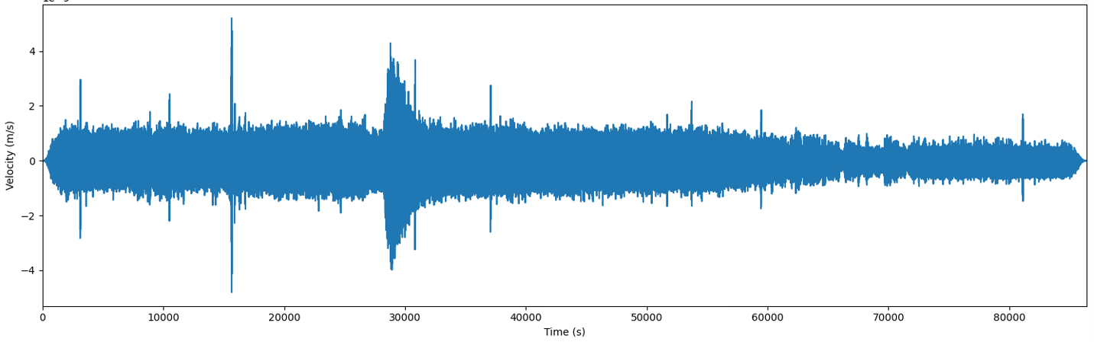
Seismic Detection Across Solar System
Team BETELWISE
Algorithm
About the Challenge
Planetary seismology missions face high power demands for transmitting continuous seismic data to Earth, much of which is unnecessary. The challenge is to develop a program that can analyze real data from the Apollo missions and Mars InSight Lander to filter out noise and identify significant seismic quakes.

Slide 9
Seismic Detection Across Solar System
Team BETELWISE
Algorithm
About the Challenge
Planetary seismology missions face high power demands for transmitting continuous seismic data to Earth, much of which is unnecessary. The challenge is to develop a program that can analyze real data from the Apollo missions and Mars InSight Lander to filter out noise and identify significant seismic quakes.

Slide 10
Seismic Detection Across Solar System
Team BETELWISE
Algorithm
Finding Best Bandpass window
About the Challenge
Planetary seismology missions face high power demands for transmitting continuous seismic data to Earth, much of which is unnecessary. The challenge is to develop a program that can analyze real data from the Apollo missions and Mars InSight Lander to filter out noise and identify significant seismic quakes.

Slide 11
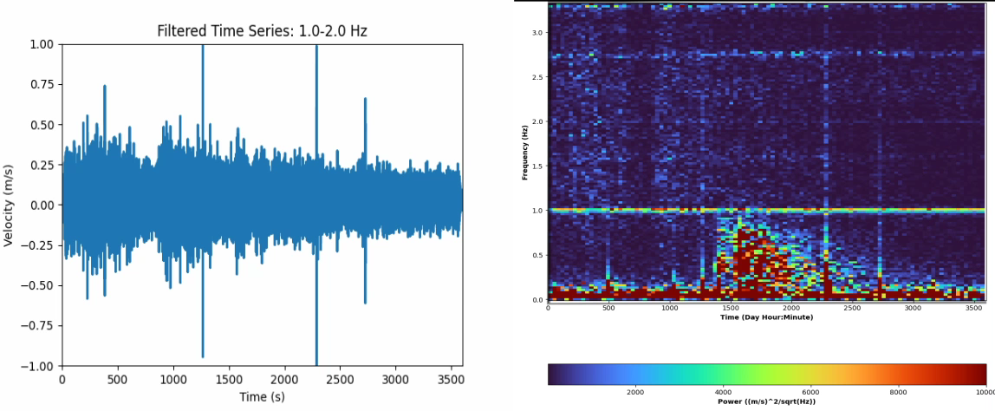
Seismic Detection Across Solar System
Team BETELWISE
Algorithm
Finding Best Bandpass window
About the Challenge
Planetary seismology missions face high power demands for transmitting continuous seismic data to Earth, much of which is unnecessary. The challenge is to develop a program that can analyze real data from the Apollo missions and Mars InSight Lander to filter out noise and identify significant seismic quakes.

Slide 12
Seismic Detection Across Solar System
Team BETELWISE
Algorithm
Finding Best Bandpass window
About the Challenge
Planetary seismology missions face high power demands for transmitting continuous seismic data to Earth, much of which is unnecessary. The challenge is to develop a program that can analyze real data from the Apollo missions and Mars InSight Lander to filter out noise and identify significant seismic quakes.
Bandpass Filter

Slide 13
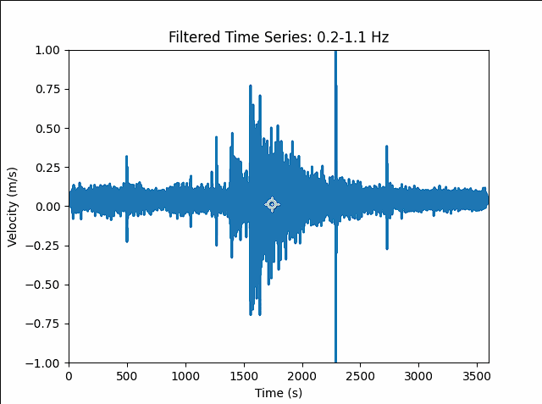
Seismic Detection Across Solar System
Team BETELWISE
Algorithm
Finding Best Bandpass window
Outlier Removal
Bandpass Filter
About the Challenge
Planetary seismology missions face high power demands for transmitting continuous seismic data to Earth, much of which is unnecessary. The challenge is to develop a program that can analyze real data from the Apollo missions and Mars InSight Lander to filter out noise and identify significant seismic quakes.

Slide 14
Seismic Detection Across Solar System
Team BETELWISE
Algorithm
Finding Best Bandpass window
Outlier Removal
Bandpass Filter
About the Challenge
Planetary seismology missions face high power demands for transmitting continuous seismic data to Earth, much of which is unnecessary. The challenge is to develop a program that can analyze real data from the Apollo missions and Mars InSight Lander to filter out noise and identify significant seismic quakes.

Slide 15
Seismic Detection Across Solar System
Team BETELWISE
Algorithm
Finding Best Bandpass window
Outlier Removal
Bandpass Filter
About the Challenge
Planetary seismology missions face high power demands for transmitting continuous seismic data to Earth, much of which is unnecessary. The challenge is to develop a program that can analyze real data from the Apollo missions and Mars InSight Lander to filter out noise and identify significant seismic quakes.

Slide 16
Seismic Detection Across Solar System
Team BETELWISE
Algorithm
Finding Best Bandpass window
Outlier Removal
Bandpass Filter
About the Challenge
Planetary seismology missions face high power demands for transmitting continuous seismic data to Earth, much of which is unnecessary. The challenge is to develop a program that can analyze real data from the Apollo missions and Mars InSight Lander to filter out noise and identify significant seismic quakes.

Slide 17
Seismic Detection Across Solar System
Team BETELWISE
Algorithm
Finding Best Bandpass window
Data Normalization
Bandpass Filter
About the Challenge
Planetary seismology missions face high power demands for transmitting continuous seismic data to Earth, much of which is unnecessary. The challenge is to develop a program that can analyze real data from the Apollo missions and Mars InSight Lander to filter out noise and identify significant seismic quakes.
Outlier Removal

Slide 18
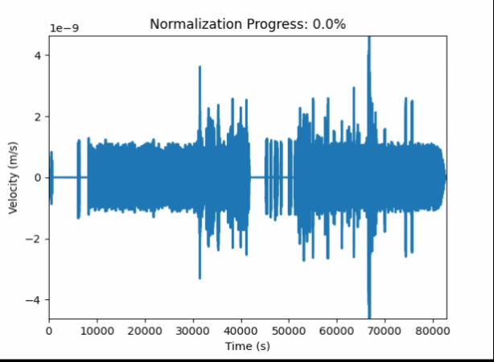
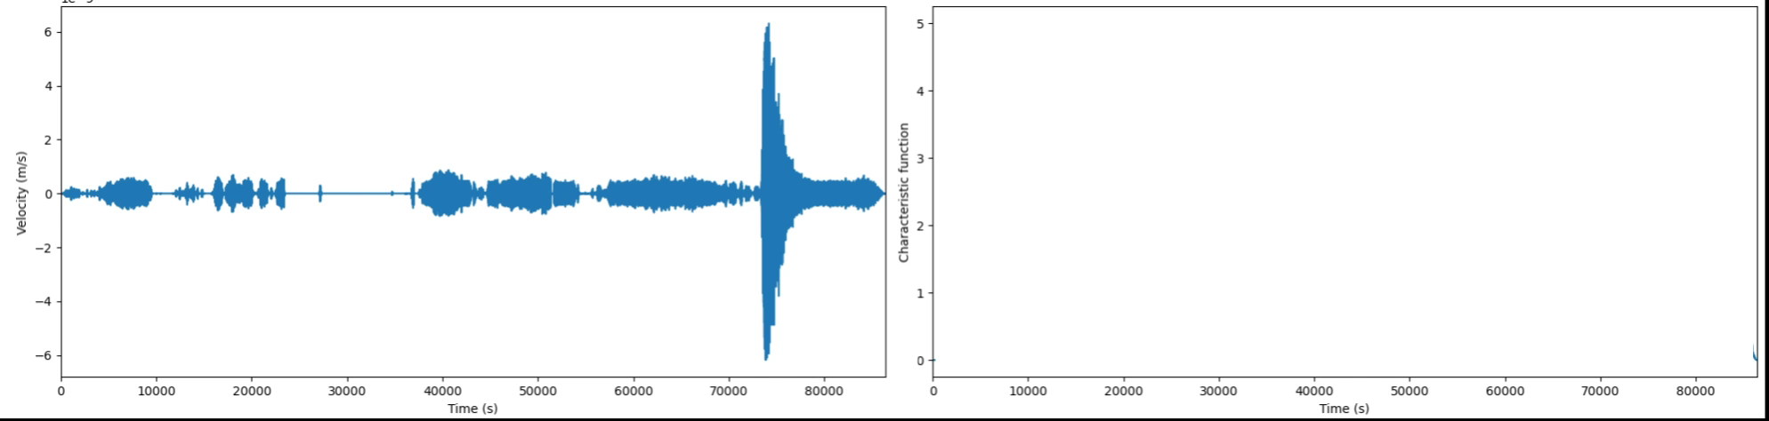
Seismic Detection Across Solar System
Team BETELWISE
Algorithm
Finding Best Bandpass window
Data Normalization
Bandpass Filter
Outlier Removal

Slide 19
Seismic Detection Across Solar System
Team BETELWISE
Algorithm
STA/LTA Analysis
Finding Best Bandpass window
Bandpass Filter
Outlier Removal
Data Normalization

Slide 20
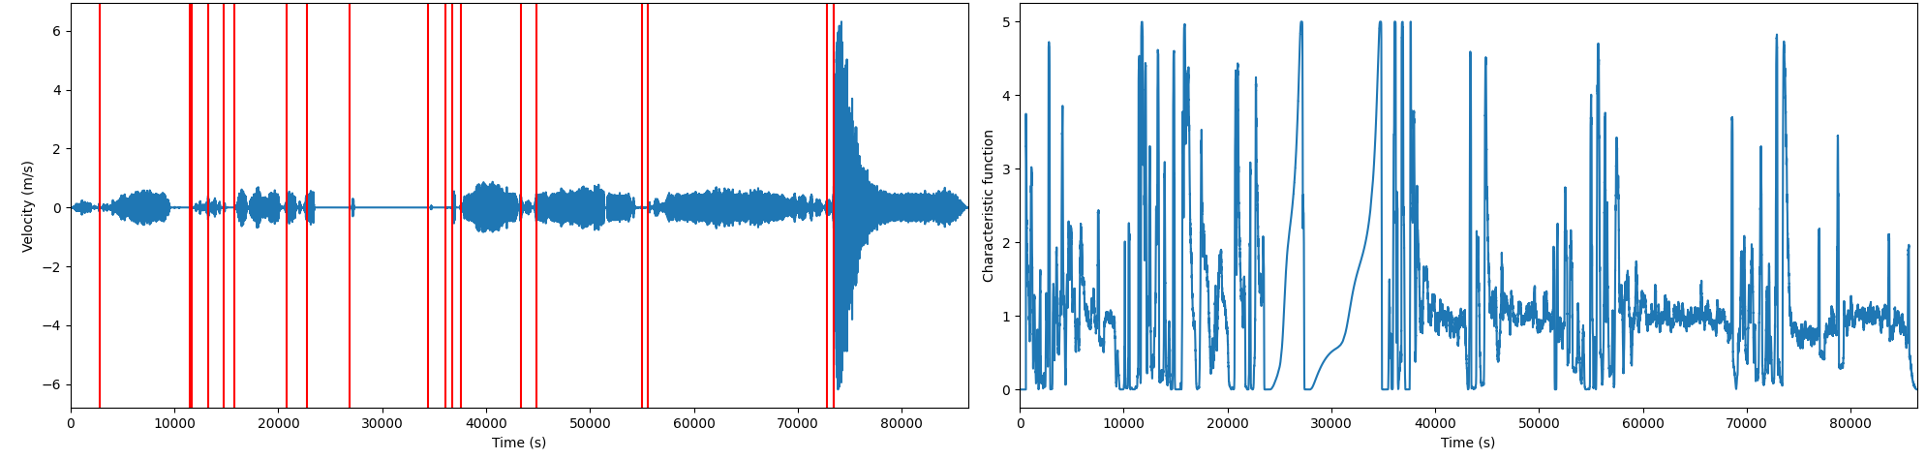
Seismic Detection Across Solar System
Team BETELWISE
Algorithm
STA/LTA Analysis
Finding Best Bandpass window
Bandpass Filter
If more false positives
False Positive Suppression
Outlier Removal
Data Normalization

Slide 21
Seismic Detection Across Solar System
Team BETELWISE
Algorithm
STA/LTA Analysis
Finding Best Bandpass window
Bandpass Filter
If more false positives
False Positive Suppression
Outlier Removal
Data Normalization

Slide 22
Seismic Detection Across Solar System
Team BETELWISE
Algorithm
CNN
Finding Best Bandpass window
STA/LTA Analysis
Bandpass Filter
If more false positives
False Positive Suppression
Outlier Removal
Data Normalization

Slide 23
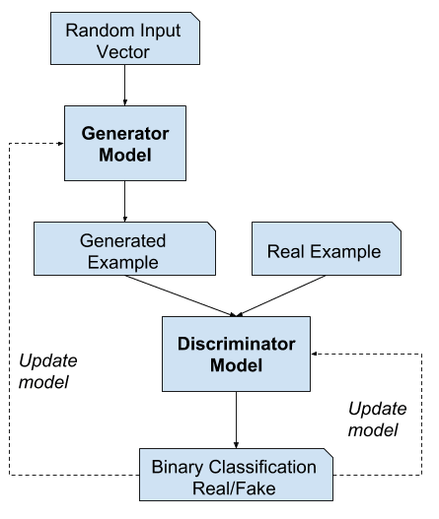
Seismic Detection Across Solar System
Team BETELWISE
Algorithm
Finding Best Bandpass window
Trained with GAN
STA/LTA Analysis
Seismogram input
Auxiliary inputs
Bandpass Filter
CNN
If more false positives
False Positive Suppression
Outlier Removal
Probability
Data Normalization
Generative Adversial Network

Slide 24
Seismic Detection Across Solar System
Team BETELWISE
Algorithm
Finding Best Bandpass window
STA/LTA Analysis
Bandpass Filter
If more false positives
False Positive Suppression
Outlier Removal
CNN
Data Normalization

Slide 25
Seismic Detection Across Solar System
Team BETELWISE
Algorithm
Finding Best Bandpass window
Cataloging
In CSV
STA/LTA Analysis
Bandpass Filter
If more false positives
False Positive Suppression
Outlier Removal
CNN
Data Normalization

Slide 26
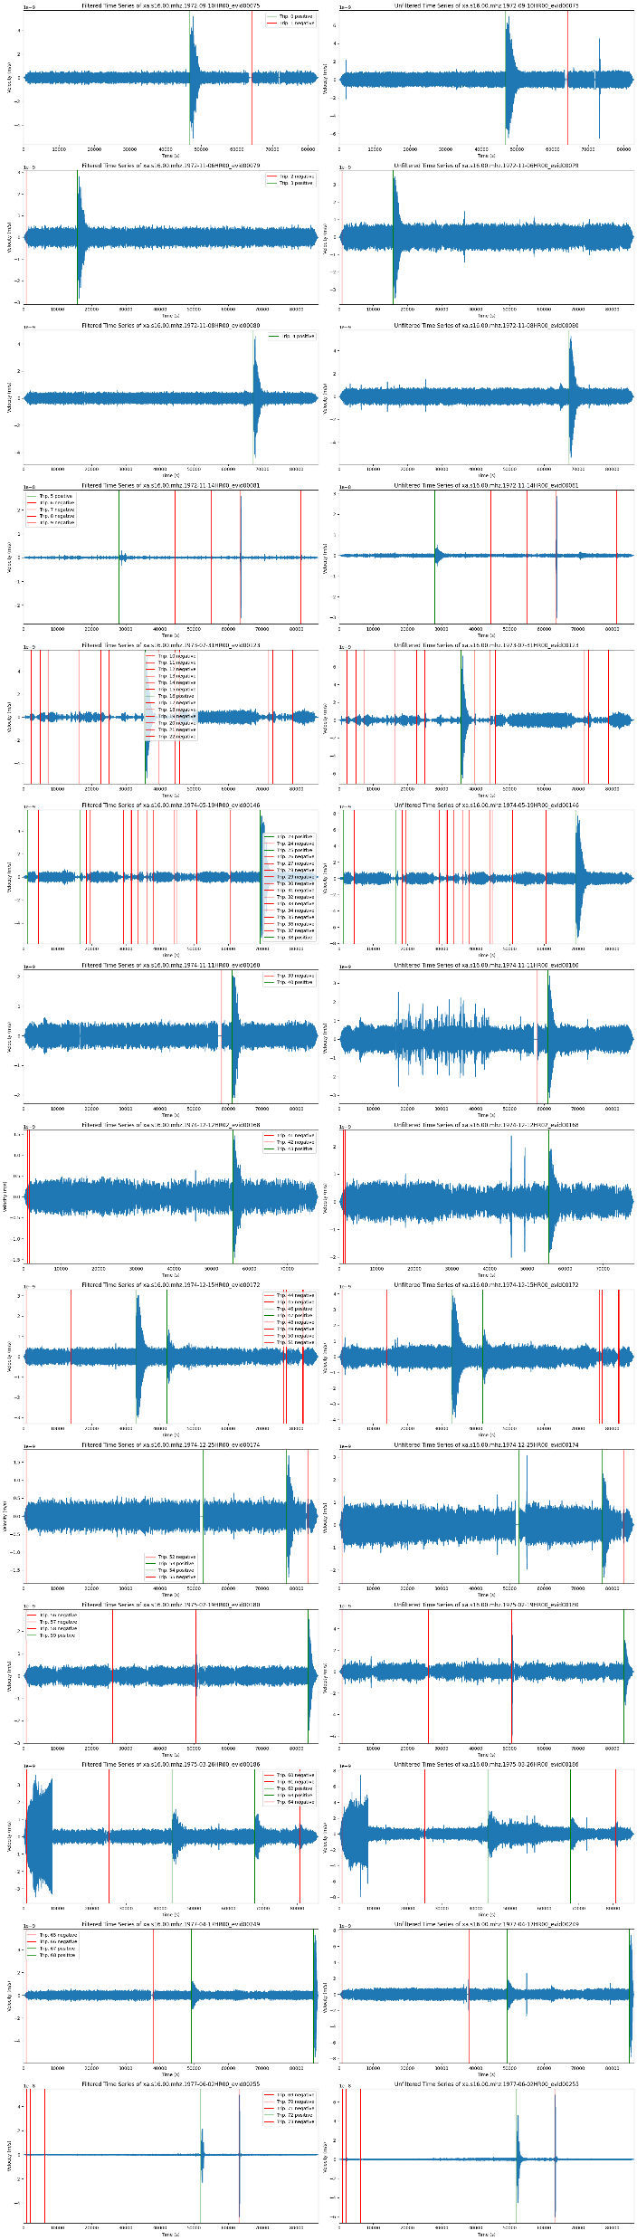
Seismic Detection Across Solar System
Team BETELWISE
Algorithm
Finding Best Bandpass window
STA/LTA Analysis
Bandpass Filter
If more false positives
False Positive Suppression
Outlier Removal
CNN
Data Normalization
Cataloging
In CSV

Slide 27
Seismic Detection Across Solar System
Team BETELWISE
Algorithm
Finding Best Bandpass window
STA/LTA Analysis
Bandpass Filter
If more false positives
False Positive Suppression
Outlier Removal
CNN
Data Normalization
Cataloging
In CSV

Slide 28
Seismic Detection Across Solar System
Team BETELWISE
Algorithm
Finding Best Bandpass window
STA/LTA Analysis
Bandpass Filter
If more false positives
False Positive Suppression
Outlier Removal
CNN
Data Normalization
Cataloging
In CSV

Slide 29
Seismic Detection Across Solar System
Team BETELWISE
Algorithm
Finding Best Bandpass window
STA/LTA Analysis
Bandpass Filter
If more false positives
False Positive Suppression
Outlier Removal
CNN
Data Normalization
Cataloging
In CSV

Slide 30
Seismic Detection Across Solar System
Team BETELWISE
Algorithm
Finding Best Bandpass window
STA/LTA Analysis
Bandpass Filter
If more false positives
False Positive Suppression
Outlier Removal
CNN
Data Normalization
Cataloging
In CSV

Slide 31
Seismic Detection Across Solar System
Team BETELWISE
Algorithm
Finding Best Bandpass window
STA/LTA Analysis
Bandpass Filter
If more false positives
False Positive Suppression
Outlier Removal
CNN
Data Normalization
Cataloging
In CSV

Slide 32
Seismic Detection Across Solar System
Team BETELWISE
Algorithm
Finding Best Bandpass window
STA/LTA Analysis
Detection >98 %
Bandpass Filter
False Positives ≈ 5 %
If more false positives
False Positive Suppression
Outlier Removal
CNN
Data Normalization
Cataloging
In CSV

Slide 33
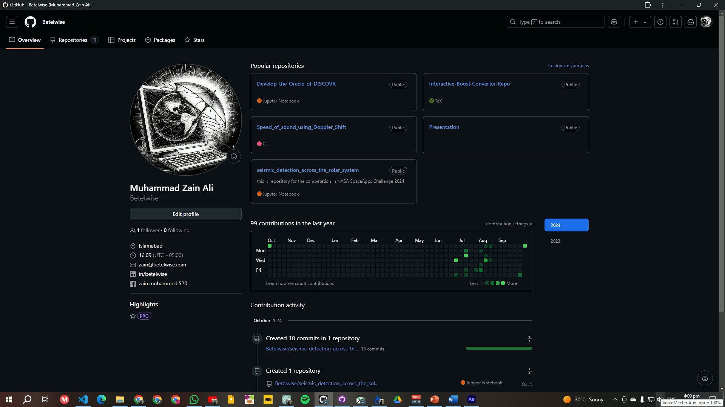
Seismic Detection Across Solar System
Team BETELWISE
Finding Best Bandpass window
STA/LTA Analysis
Detection >98 %
Bandpass Filter
False Positives ≈ 5 %
If more false positives
False Positive Suppression
Outlier Removal
CNN
Data Normalization
Cataloging
In CSV

Slide 34
Seismic Detection Across Solar System
Team BETELWISE
Finding Best Bandpass window
STA/LTA Analysis
Bandpass Filter
If more false positives
False Positive Suppression
Outlier Removal
Github.com/betelwise
CNN
Email
Data Normalization
zain@betelwise.com
Cataloging
In CSV

